Slide 1
CS174A Lecture 6

Slide 2
Announcements & Reminders
2/04/24: A2 due; will be discussed during this week’s TA session
2/07&2/08 (Noon-1PM): Office hours, Zoom
2/08/24: Midterm Exam: 6:00-7:30 PM PST, in person, in class
2/25/24: A3 due
Start forming your project teams (team size: 2-4)
2/28/24: initial project proposals & teams due
3/13/24: final proposals due

Slide 3
Last Lecture Recap
Polygons (triangles)
Transformations: translation, scaling, rotation, shear
Geometrical representation
Mathematical representation
Homogeneous representation
Inverse of Transformations

Slide 4
Next Up
Concatenation of transformations
Spaces: Model, Object/World, Eye/Camera, Screen
Projections: parallel and perspective
Midterm
Lighting
Flat and Smooth Shading

Slide 5
SIGGRAPH trailers from 2014
Going backwards,
https://www.youtube.com/watch?v=s8lzXMWMngU
And
https://www.youtube.com/watch?v=u3Z1hDwGEmM

Slide 6
Rendering Pipeline
MODEL
SPACE
Transformation
Matrix (TM)
WORLD
SPACE
Eye
Matrix (EM)
EYE
SPACE
Translation, Scaling, Rotation, Shear
????
Window-To-Viewport Mapping (WTV)
Projection
Matrix (PM)
SCREEN
SPACE
PROJECTION
SPACE
????
????

Slide 7
Linear Combination of Vectors
Definition
A linear combination of the m vectors v₁,…,v_{m} is a vector of the form:
w = a₁v₁ +…+ a_{m}v_{m}, a₁,…,a_{m} in R

Slide 8
Special Cases
Linear combination
w = a₁v₁+…a_{m}v_{m}, a₁,…,a_{m} in R
Affine combination:
A linear combination for which a₁+…+a_{m}=1
Convex combination
An affine combination for which a_{i}≥0 for i=1,…,m

Slide 9
Linear Combination of Points
Points P, Q scalars a, b:
P’ = a*P + b*Q = a [p₁, p₂, p₃,1]^{T} + b[q₁, q₂, q₃,1]^{T} = [ap₁+bq₁, ap₂+bq₂, ap₃+bq₃, a+b]^{T}
Affine combination ⇒ a + b = 1
P’ = (1-a)*P + a*Q
Convex combination ⇒ a + b = 1 AND a, b ≥ 0

Slide 10
Linear Operations
Makes sense for linear as well as affine:
Addition of 2 vectors
Multiplication of vector by a scalar
Addition of a vector and a point
Doesn’t make sense for linear, but ok for affine:
Addition of 2 points
Multiplication of a point by a scalar

Slide 11
Affine Transformations/Interpolations
Examples: translations, rotations, scaling, shear
Preserves:
Collinear points
Planarity
Parallelism of lines and planes
Relative ratios of edge lengths

Slide 12
Linear Vs. Affine Transformations
A linear transformation only takes linear combinations of x, y, and z
Point at origin stays on the origin forever
An *affine* transformation is more general and more powerful
It’s called an affine transformation because it preserves affine combinations (line segment interpolations don’t get messed up before vs. after)

Slide 13
Summary: Affine is Useful
Affine transformations are the main modeling tool in graphics
They are applied as matrix multiplications
Any affine transformation can be performed as a series of elementary affine transformations
We can now do object placement
Model entire scenes

Slide 14
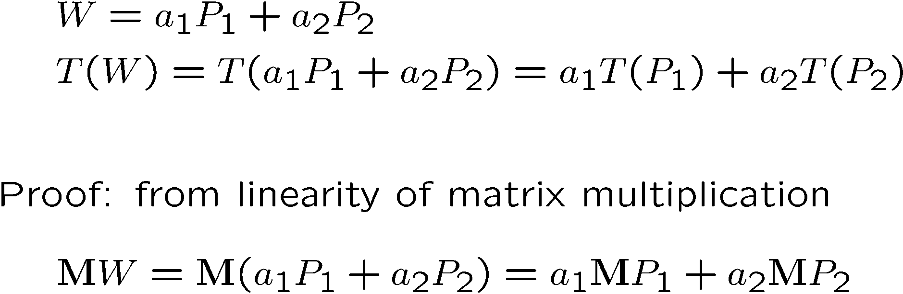
Affine Combinations of Points

Slide 15
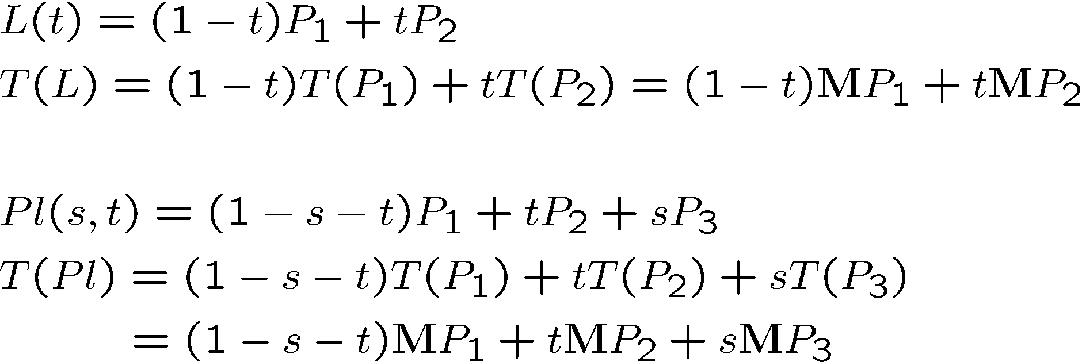
Preservations of Lines and Planes

Slide 16
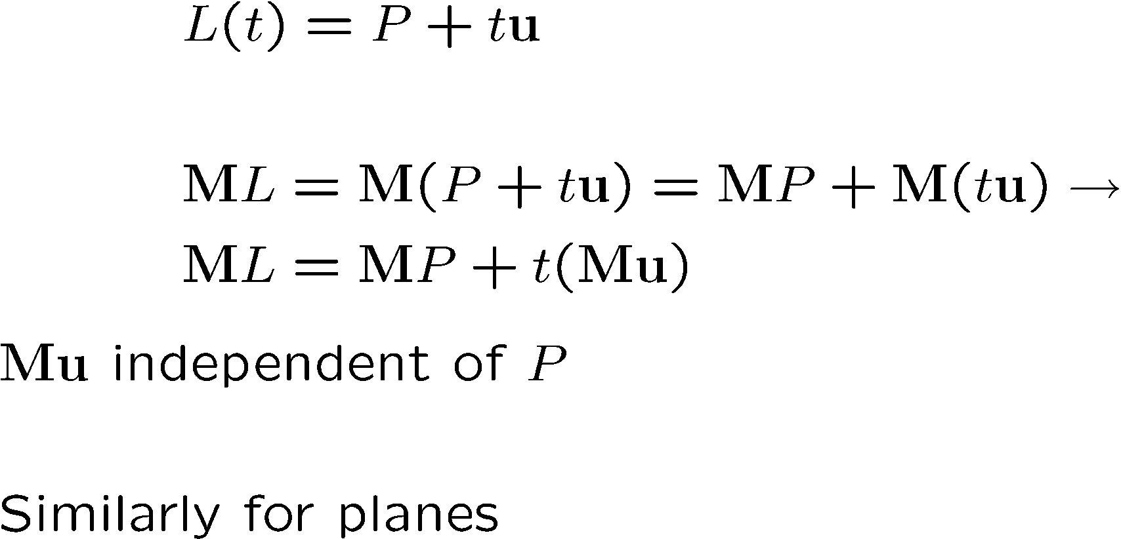
Preservation of Parallelism

Slide 17
Rigid Body Transformations
Examples: translations and rotations
Preserves lines, angles and distances

Slide 18
Affine Transforms Review

Slide 19
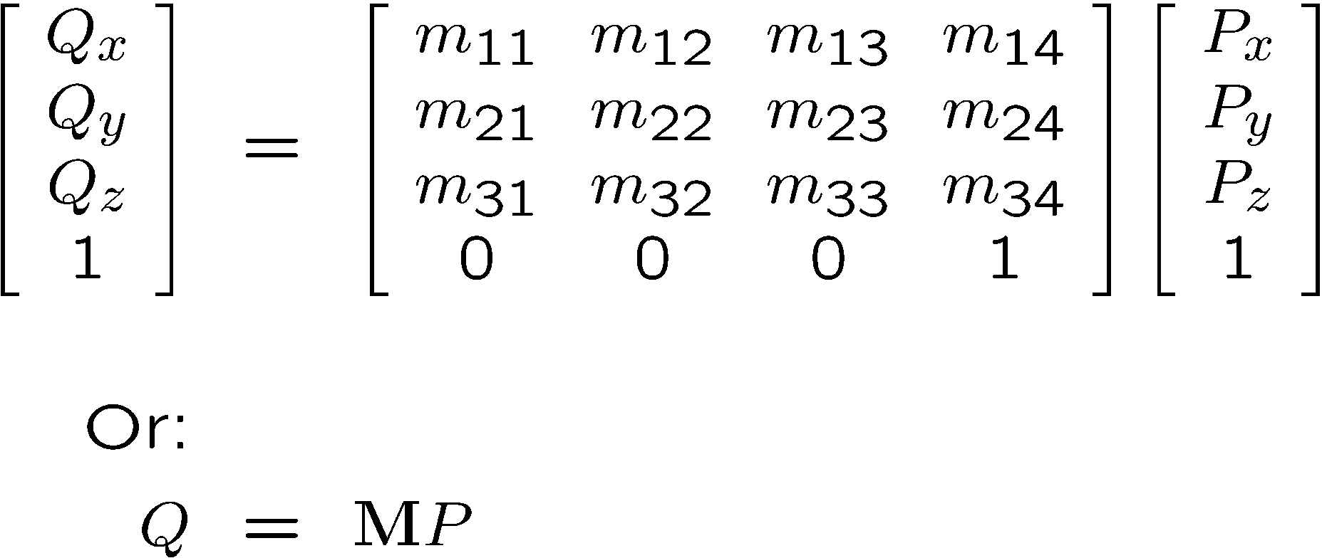
Affine Transformations in 3D
General form

Slide 20
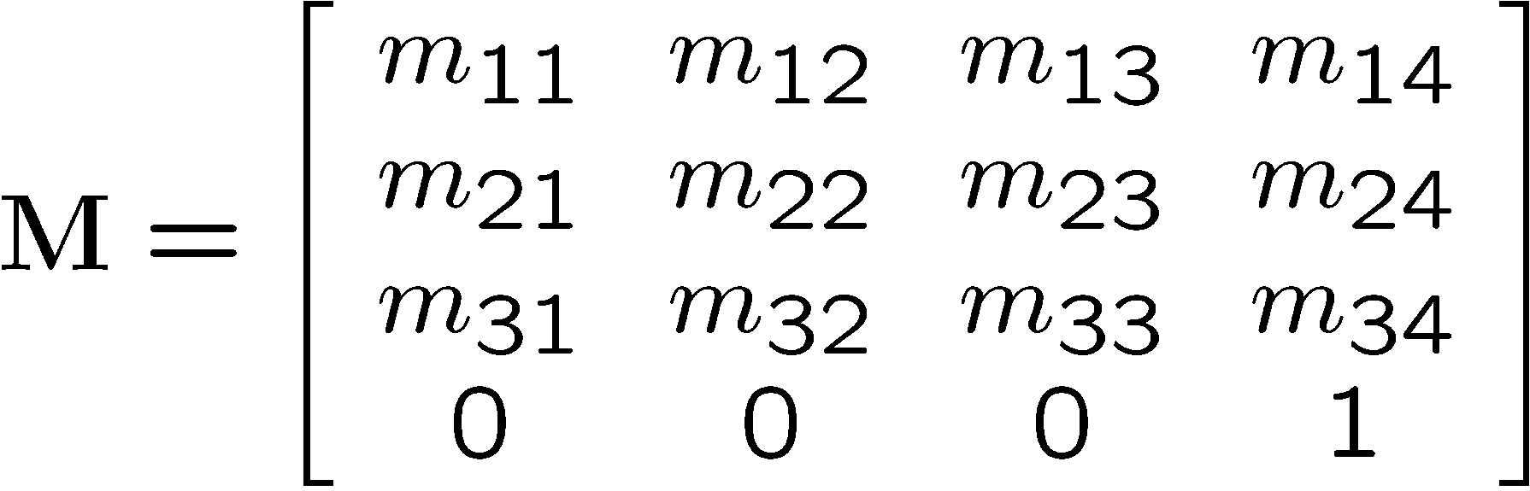
General Form
Rotation / Scaling / Shearing
Translation

Slide 21
Examples of Tranformation Composition
Rotation followed by translation vs. translation followed by rotation
Commutative and associative properties
Rotation about a random point (not the origin)
Rotation about a random axis
Transforming a vector/normal
For vertices/points transformation matrix = M
For vectors (normals) = (M^{T})⁻¹

Slide 22
Matrix Order
Remember the rules:
Non-Commutativity:
ABCDE != BACDE != EDCBA
Matrix products can only be written in one left-right order. Changing the order changes the answer.
Associativity:
Matrix products can be evaluated in any left-right order you want, though.
ABCDE = A(B(C(DE))) = (((AB)C)D)E

Slide 23
Matrix Multiplication is NOT commutative.
Given Matrix A and Matrix B that are non-trivial nor diagonal,
AB != BA

Slide 24
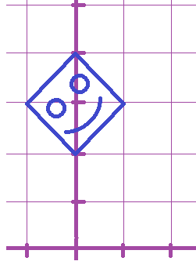

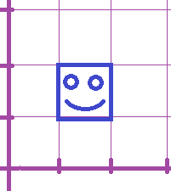


Matrix Multiplication is NOT commutative.
Remember our old rotation matrix:

Slide 25

Matrix Multiplication is NOT commutative.
Suppose we modify it with a non-uniform scale matrix from the left:
Where do the corners of the face go if we use this one?

Slide 26

Matrix Multiplication is NOT commutative.
Suppose we modify it with a non-uniform scale matrix from the left:
Where do the corners of the face go if we use this one?

Slide 27


Matrix Multiplication is NOT commutative.
Suppose we modify it with a non-uniform scale matrix from the left:
Where do the corners of the face go if we use this one?

Slide 28
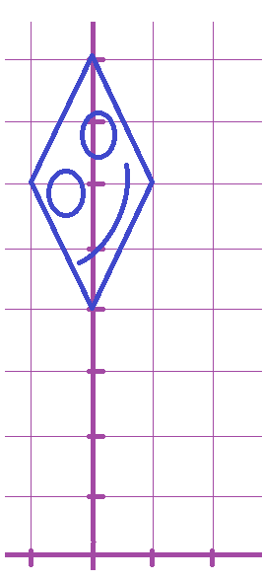




Matrix Multiplication is NOT commutative.
Suppose we modify it with a non-uniform scale matrix from the left:
We sheared it!

Slide 29
Matrix Multiplication is NOT commutative.
Let’s try the product the other way around now...

Slide 30

Matrix Multiplication is NOT commutative.
Suppose we modify it with a non-uniform scale matrix from the right:
Where do the corners of the face go if we use this one?

Slide 31

Matrix Multiplication is NOT commutative.
Suppose we modify it with a non-uniform scale matrix from the right:
Where do the corners of the face go if we use this one?

Slide 32


Matrix Multiplication is NOT commutative.
Suppose we modify it with a non-uniform scale matrix from the right:
Where do the corners of the face go if we use this one?

Slide 33

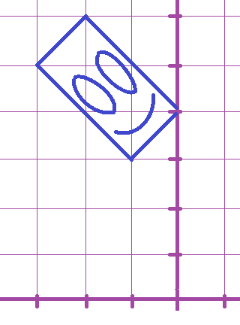



Matrix Multiplication is NOT commutative.
Suppose we modify it with a non-uniform scale matrix from the right:
We didn’t shear it!

Slide 34
Matrix Order
Remember the rules:
Non-Commutativity:
ABCDE != BACDE != EDCBA
Matrix products can only be written in one left-right order. Changing the order changes the answer.
Associativity:
Matrix products can be evaluated in any left-right order you want, though.
ABCDE = A(B(C(DE))) = (((AB)C)D)E

Slide 35
Rotation Around an Arbitrary Axis
Euler’s theorem:
Any rotation or sequence of rotations around a point is equivalent to a single rotation around an axis that passes through the point
Let’s derive the transformation matrix for rotation around an arbitrary axis u

Slide 36
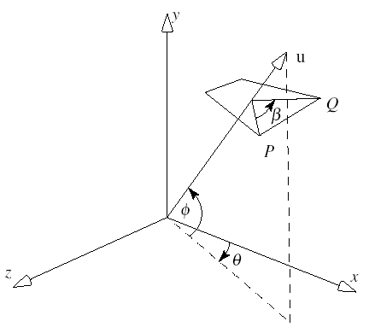
Rotation Around an Arbitrary Axis
Vector (axis): u = [u_{x}, u_{y}, u_{z}]^{T}
Rotation angle: β
Point: P
Method:
Two rotations to align u with x-axis
Do x-roll by β
Undo the alignment

Slide 37
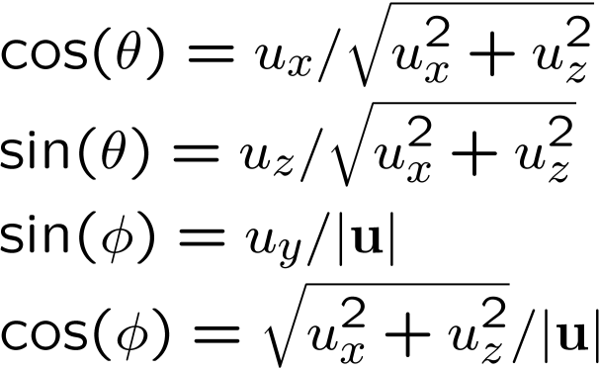
Derivation
R_{z}(-φ) R_{y}(θ)
R_{x}(β)
R_{y}(-θ) R_{z}(φ)
All together: R_{u}(β) =
R_{y}(-θ) R_{z}(φ) R_{x}(β) R_{z}(-φ) R_{y}(θ)
We should add translation too if the axis is not through the origin
Notes:
An arbitrary rotation can be represented by a product of five matrices based on three angles.

Slide 38
Transformations of Coordinate Systems
Coordinate systems consist of basis vectors and an origin (point)
They can be represented as affine matrices
Therefore, we can transform them just like points and vectors
This provides an alternative way to think of transformations:
As changes of coordinate systems

Slide 39
Remember
Transformations are represented
by affine matrices
Coordinate systems too:
Rotate/Scale/Shear
Translate
Basis
Vector 1
Basis
Vector 2
Basis
Vector 3
Origin
Point

Slide 40
Transforming a Point by Transforming Coordinate Systems

Slide 41
Transforming a Point by Transforming Coordinate Systems
T₁

Slide 42
Transforming a Point by Transforming Coordinate Systems
T₂
T₁

Slide 43
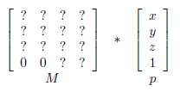
Matrix Review
All the objects you draw on screen are drawn one vertex at a time, by starting with the vertex's xyz coordinate and then multiplying by a matrix to get the final xy coordinate on the screen.

Slide 44
Transforms
Before that matrix, the xyz coordinate is always some trivial value like (.5, .5, .5)
In the reference system of the shape itself
For example, a cube's own coordinates for its corners
After that matrix, it's some different xy pixel coordinate denoting where that vertex will show up on the screen.
And z for depth, and a fourth number for translations / perspective effects
That mapping is all that the transform does.

Slide 45
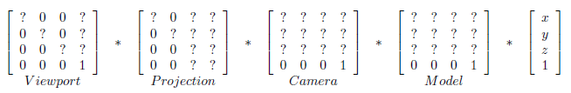
Transform Process
The transform is always just one 4x4 matrix.
But calculating what it should be involves multiplying out a big chain of intermediate special matrices. That chain is always: equation:

Slide 46
Transform Process
Note: We never actually see the viewport matrix.
The viewport matrix is automatically applied for you at the end of the vertex shader.
Early during initialization, javascript set it up, calling gl.viewport(x,y,width,height).
All the other special matrices you do manage.

Slide 47
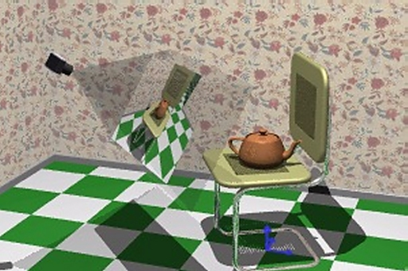
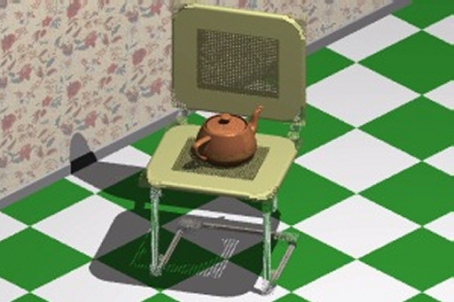
Rendering a 3D Scene From the Point of View of a Virtual Camera

Slide 48
Transform Process
The camera matrix is very much like the model transform matrix for placing shapes. But:
The shape being placed is the scene’s observer
You actually use the inverse matrix of what you would have done to a 3D model of an actual camera

Slide 49
Rendering Pipeline
MODEL
SPACE
Transformation
Matrix (TM)
WORLD
SPACE
Eye
Matrix (EM)
EYE
SPACE
Translation, Scaling, Rotation, Shear
Eye, COI, Top/Tilt
Window-To-Viewport Mapping (WTV)
Projection
Matrix (PM)
SCREEN
SPACE
PROJECTION
SPACE
????
????

